Slide 1

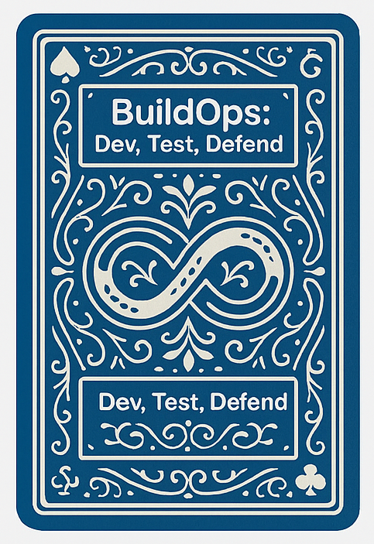
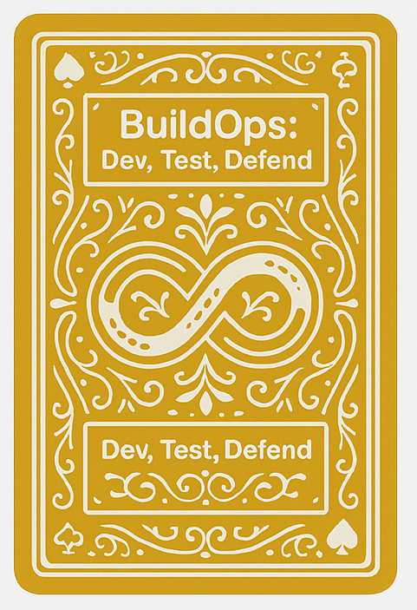
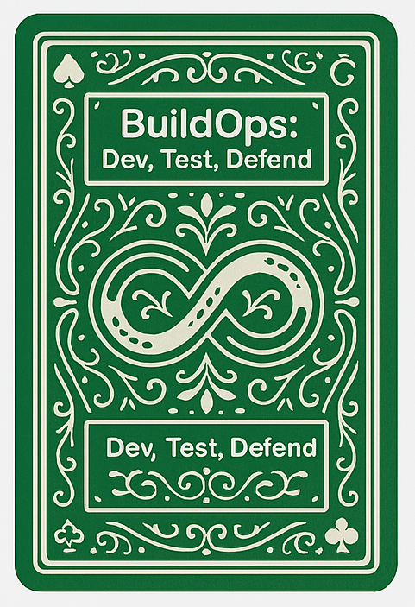
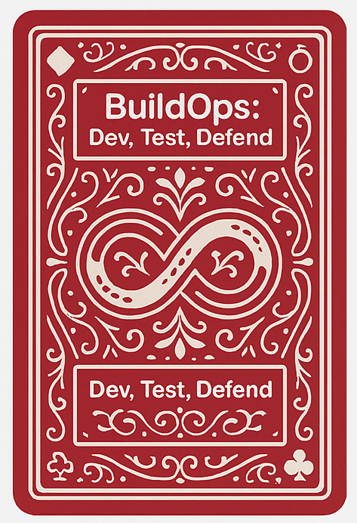
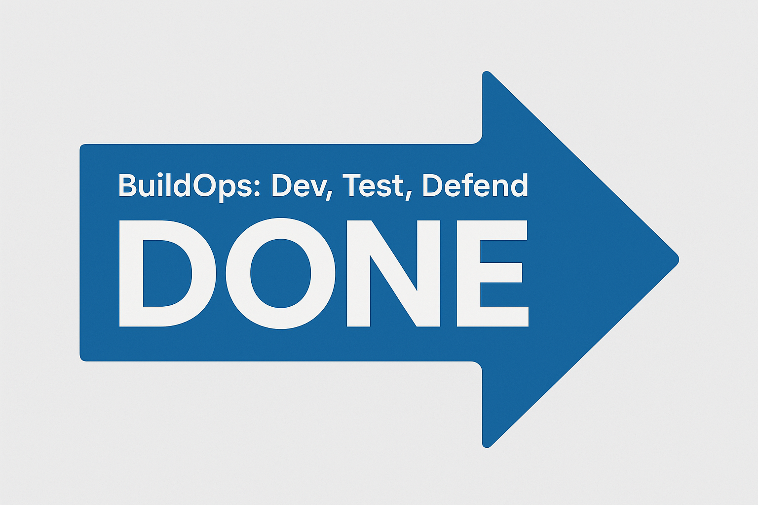
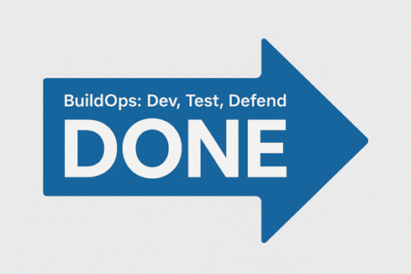
BuildOps: Dev, Test, Defend Playing Board
Learn high level concepts of DevSecOps through gamification.
DONE
Scheduled Work
Customer PBIs
Security PBIs
Sprint Results
Attacks
Backlog
Score Sheet

